Slide 1
Vector Mechanics For Engineers: Dynamics Twelfth Edition
Copyright © 2020 McGraw Hill , All Rights Reserved.
PROPRIETARY MATERIAL © 2020 The McGraw Hill Inc. All rights reserved. No part of this PowerPoint slide may be displayed, reproduced or distributed in any form or by any means, without the prior written permission of the publisher, or used beyond the limited distribution to teachers and educators permitted by McGraw Hill for their individual course preparation. If you are a student using this PowerPoint slide, you are using it without permission.

Slide 2
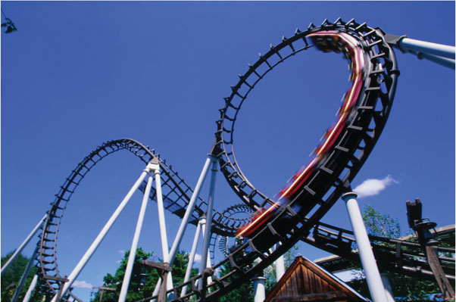
Chapter 12
Kinetics of Particles: Newton’s Second Law

Slide 3
Contents
Introduction
Newton’s Second Law of Motion
Linear Momentum of a Particle
Systems of Units
Equations of Motion
Dynamic Equilibrium
Sample Problem 12.1
Sample Problem 12.3
Sample Problem 12.5
Sample Problem 12.6
Sample Problem 12.7
Sample Problem 12.10
Angular Momentum of a Particle
Equations of Motion in Radial & Transverse Components
Conservation of Angular Momentum
Newton’s Law of Gravitation
Sample Problem 12.12
Trajectory of a Particle Under a Central Force
Application to Space Mechanics
Sample Problem 12.14
Kepler’s Laws of Planetary Motion

Slide 4
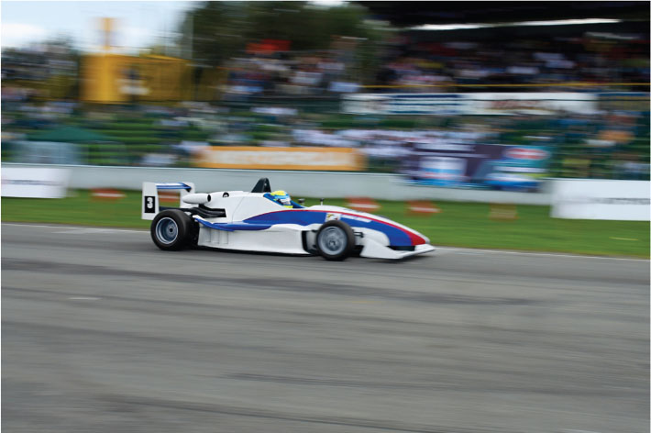
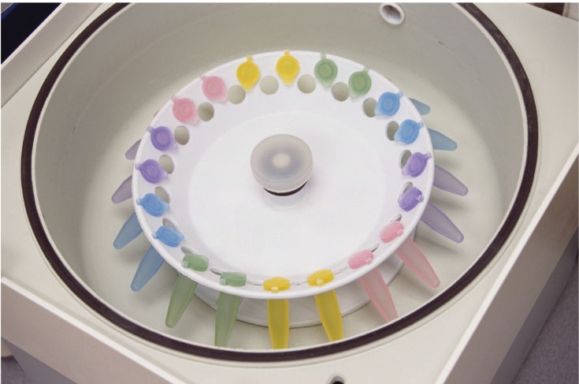
Kinetics of Particles
We must analyze all of the forces acting on the racecar in order to design a good track
As a centrifuge reaches high velocities, the arm will experience very large forces that must be considered in design.
©Glow Images RF , Russell lllig/Getty Images RF
,

Slide 5
Introduction
Newton’s Second Law of Motion
If the resultant force acting on a particle is not zero, the particle will have an acceleration proportional to the magnitude of resultant and in the direction of the resultant.
Must be expressed with respect to a Newtonian (or inertial) frame of reference, i.e., one that is not accelerating or rotating.
This form of the equation is for a constant mass system.

Slide 6
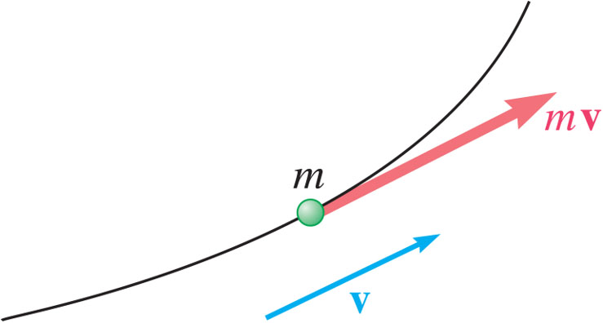
Linear Momentum of a Particle
Replacing the acceleration by the derivative of the velocity yields,
Linear Momentum Conservation Principle: If the resultant force on a particle is zero, the linear momentum of the particle remains constant in both magnitude and direction.

Slide 7
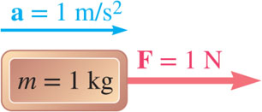
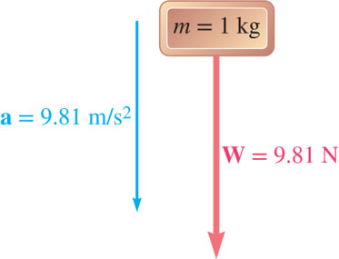
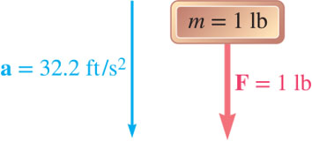
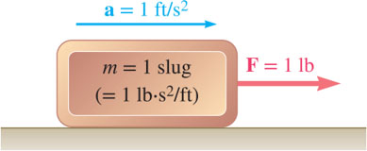
Systems of Units
Of the units for the four primary dimensions (force, mass, length, and time), three may be chosen arbitrarily. The fourth must be compatible with Newton’s 2nd Law.
International System of Units (SI Units): base units are the units of length (m), mass (kg), and time (second). The unit of force is derived,
U.S. Customary Units: base units are the units of force (lb), length (m), and time (second). The unit of mass is derived,

Slide 8
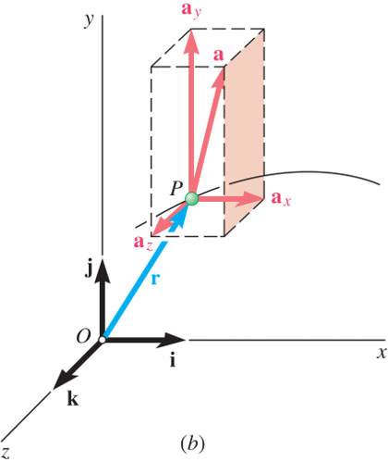
Equations of Motion 1
Newton’s second law
Can use scalar component equations, example for rectangular components,

Slide 9
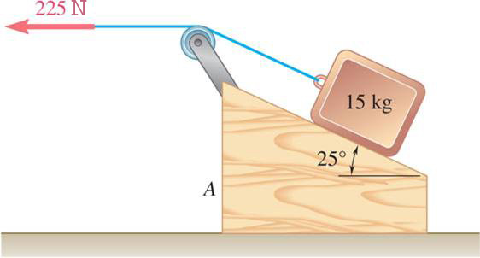
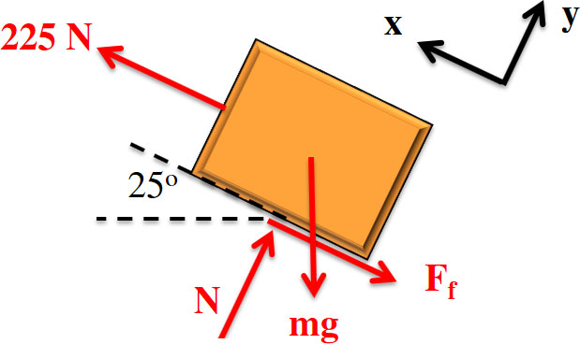
Free Body Diagrams and Kinetic Diagrams 1
The free body diagram is the same as you have done in statics; we will add the kinetic diagram in our dynamic analysis.
1. Isolate the body of interest (free body).
2. Draw your axis system (example: Cartesian, polar, path).
3. Add in applied forces (example: weight, 225 N pulling force).
4. Replace supports with forces (example: normal force).
5. Draw appropriate dimensions (usually angles for particles).

Slide 10
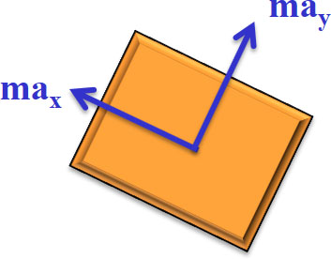
Free Body Diagrams and Kinetic Diagrams 2
Put the inertial terms for the body of interest on the kinetic diagram.
1. Isolate the body of interest (free body).
2. Draw in the mass times acceleration of the particle; if unknown, do this in the positive direction according to your chosen axes.

Slide 11
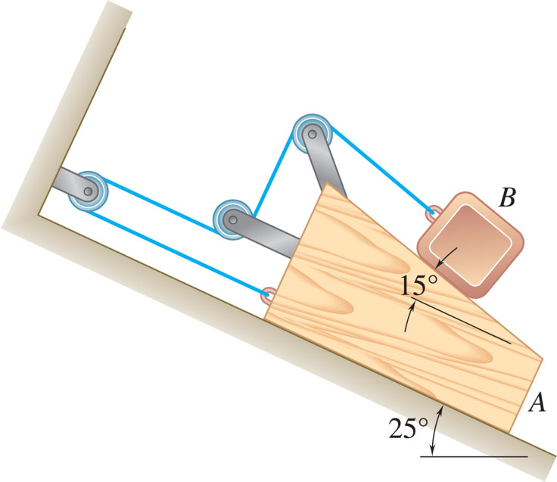
Free Body Diagrams and Kinetic Diagrams 3
Draw the FBD and KD for block A (note that the massless, frictionless pulleys are attached to block A and should be included in the system).

Slide 12

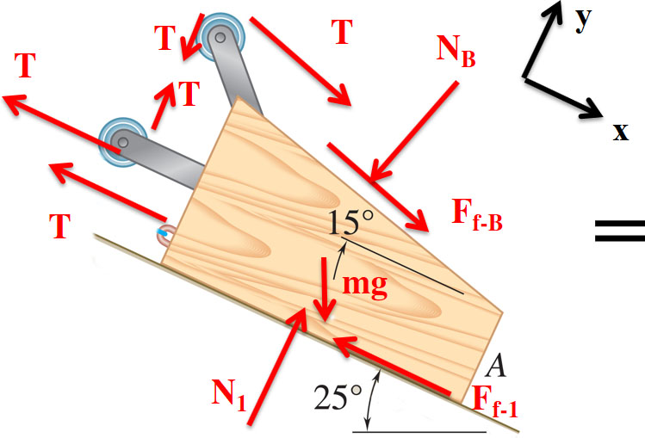
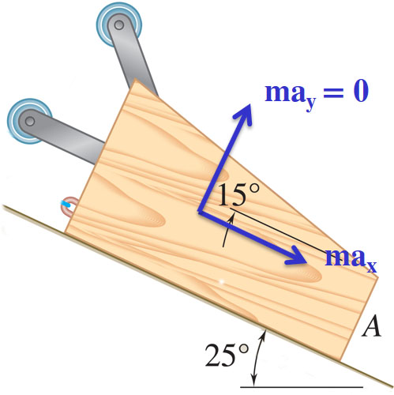
Free Body Diagrams and Kinetic Diagrams 4
1. Isolate body
2. Axes
3. Applied forces
4. Replace supports with forces
5. Dimensions (already drawn)
6. Kinetic diagram

Slide 13
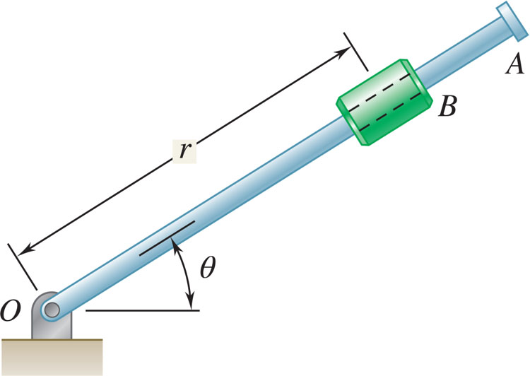
Free Body Diagrams and Kinetic Diagrams 5
Draw the FBD and KD for the collar B. Assume there is friction acting between the rod and collar, motion is in the vertical plane, and θ is increasing

Slide 14
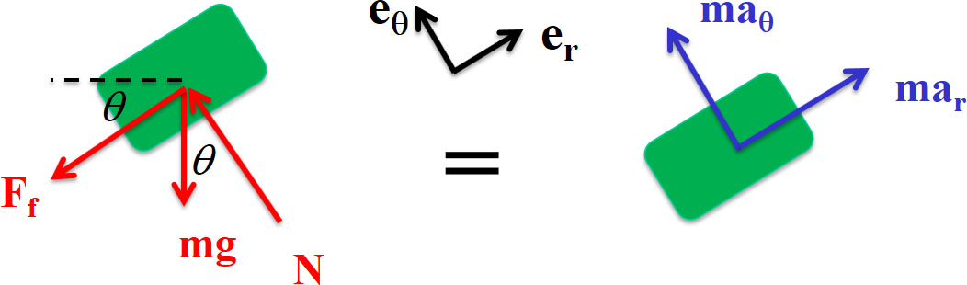
Free Body Diagrams and Kinetic Diagrams 6
1. Isolate body
2. Axes
3. Applied forces
4. Replace supports with forces
5. Dimensions
6. Kinetic diagram

Slide 15
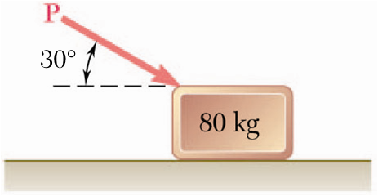
Sample Problem 12.1 1
Strategy:
Resolve the equation of motion for the block into two rectangular component equations.
Unknowns consist of the applied force P and the normal reaction N from the plane. The two equations may be solved for these unknowns.
A 80-kg block rests on a horizontal plane. Find the magnitude of the force P required to give the block an acceleration of 2.5 m/s² to the right. The coefficient of kinetic friction between the block and plane is μ_{k} = 0.25.

Slide 16
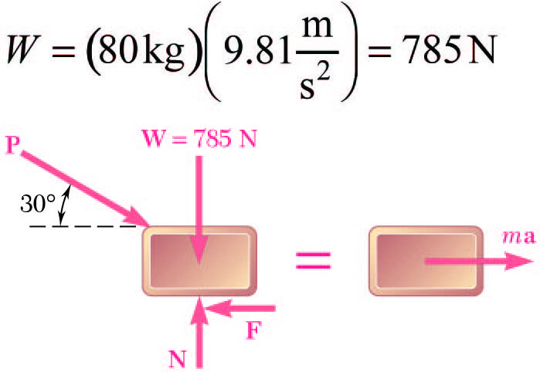
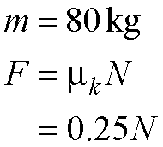
Sample Problem 12.1 2
Modeling and Analysis:
Resolve the equation of motion for the block into two rectangular component equations.
y
O
x
Unknowns consist of the applied force P and the normal reaction N from the plane. The two equations may be solved for these unknowns.

Slide 17
Sample Problem 12.1 3
Reflect and Think
When you begin pushing on an object, you first have to overcome the static friction force (F = μ_{s}N) before the object will move.
Also note that the downward component of force P increases the normal force N, which in turn increases the friction force F that you must overcome.

Slide 18
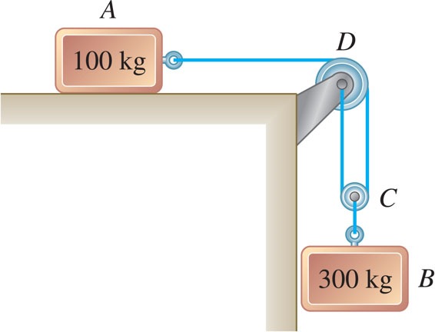
Sample Problem 12.3 1
Strategy:
Write the kinematic relationships for the dependent motions and accelerations of the blocks.
Write the equations of motion for the blocks and pulley.
Combine the kinematic relationships with the equations of motion to solve for the accelerations and cord tension.
The two blocks shown start from rest. The horizontal plane and the pulley are frictionless, and the pulley is assumed to be of negligible mass. Determine the acceleration of each block and the tension in the cord.

Slide 19
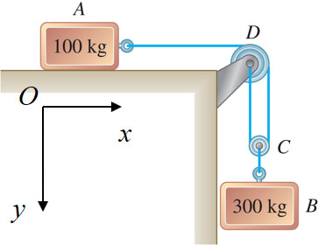
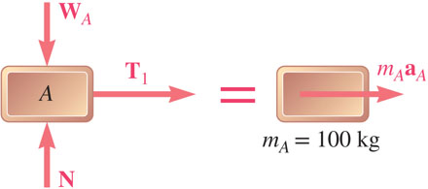
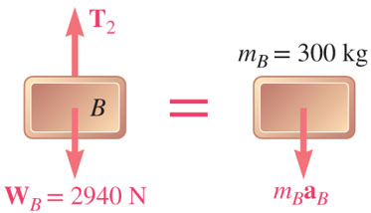
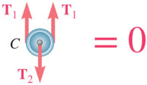
Sample Problem 12.3 2
Modeling and Analysis:
Write the kinematic relationships for the dependent motions and accelerations of the blocks.
Write equations of motion for blocks and pulley.

Slide 20
Sample Problem 12.3 3
Combine kinematic relationships with equations of motion to solve for accelerations and cord tension.

Slide 21
Sample Problem 12.3 4
Reflect and Think
Note that the value obtained for T₂ is not equal to the weight of block B. Rather than choosing B and the pulley as separate systems, you could have chosen the system to be B and the pulley. In this case, T₂ would have been an internal force.

Slide 22
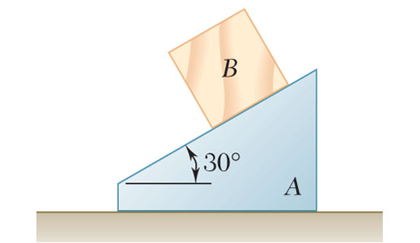
Sample Problem 12.5 1
Strategy:
The block is constrained to slide down the wedge. Therefore, their motions are dependent. Express the acceleration of block as the acceleration of wedge plus the acceleration of the block relative to the wedge.
Write the equations of motion for the wedge and block.
The 6-kg block B starts from rest and slides on the 15-kg wedge A, which is supported by a horizontal surface.
Neglecting friction, determine (a) the acceleration of the wedge, and (b) the acceleration of the block relative to the wedge.
Solve for the accelerations.

Slide 23
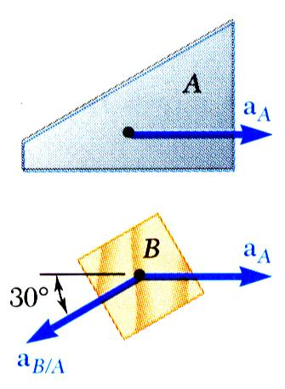
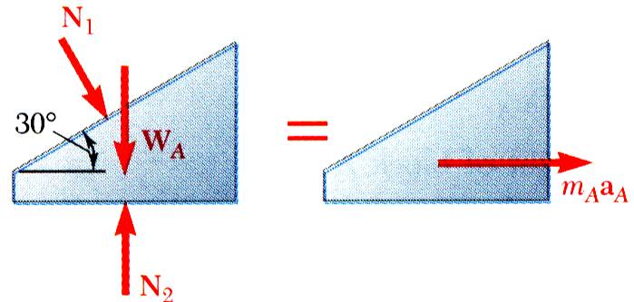
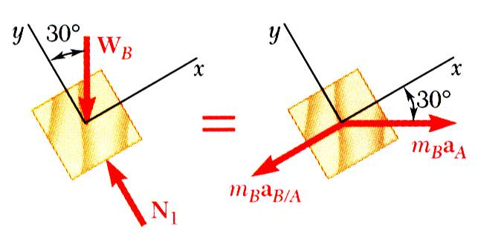
Sample Problem 12.5 2
Modeling and Analysis:
The block is constrained to slide down the wedge. Therefore, their motions are dependent.
Write equations of motion for wedge and block.
y
x

Slide 24
Sample Problem 12.5 3
Solve for the accelerations.

Slide 25
Sample Problem 12.5 4
Reflect and Think
Many students are tempted to draw the
acceleration of block B down the incline in the kinetic diagram. It is important to recognize that this is the direction of the relative acceleration. Rather than the kinetic diagram you used for block B, you could have simply put unknown accelerations in the x and y directions and then used your relative motion equation to obtain more scalar equations.

Slide 26
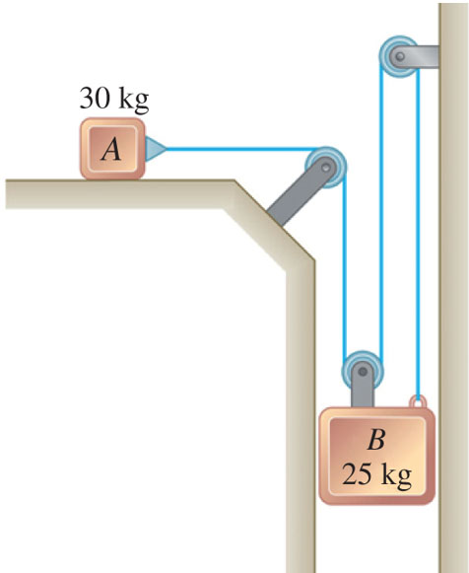
Group Problem Solving 1
Strategy:
Write the kinematic relationships for the dependent motions and accelerations of the blocks.
Draw the FBD and KD for each block
Write the equations of motion for the blocks and pulley.
Combine the kinematic relationships with the equations of motion to solve for the accelerations and cord tension.
The two blocks shown are originally at rest. Neglecting the masses of the pulleys and the effect of friction in the pulleys and between block A and the horizontal surface, determine (a) the acceleration of each block, (b) the tension in the cable.

Slide 27
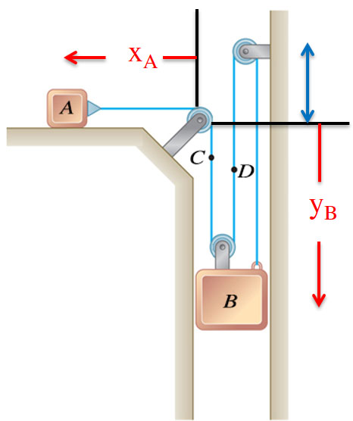
Group Problem Solving 2
Modeling and Analysis:
Write the kinematic relationships for the dependent motions and accelerations of the blocks.
This is the same problem worked last chapter - write the constraint equation.
Differentiate this twice to get the acceleration relationship.
(1)

Slide 28
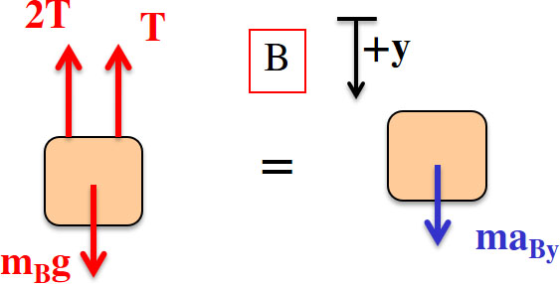
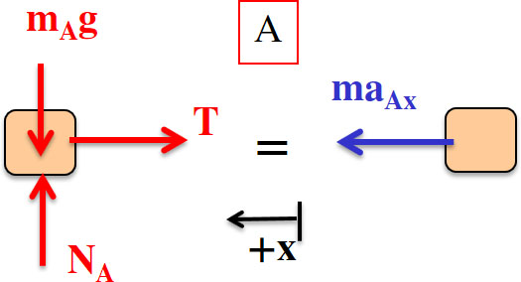
Group Problem Solving 3
Draw the FBD and KD for each block,
Write the equation of motion for each block,
(2)
From Equation (1)
(3)
Solve the three equations, 3 unknowns,
(3) → (2)

Slide 29
Group Problem Solving 4
Reflect and Think:
The acceleration of Block A is to the right as would be expected
The tension force in the cable has to be less than 1/3 of the weight of Block B. (Otherwise the block would not move downward)

Slide 30
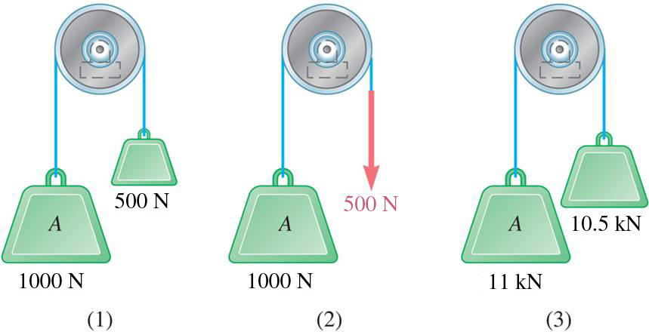
Concept Quiz 1
The three systems are released from rest. Rank the accelerations, from highest to lowest.
a) (1) > (2) > (3)
d) (1) = (2) = (3)
b) (1) = (2) > (3)
e) (1) = (2) < (3)
c) (2) > (1) > (3)

Slide 31
Concept Quiz 2
The three systems are released from rest. Rank the accelerations, from highest to lowest.
a) (1) > (2) > (3)
d) (1) = (2) = (3)
b) (1) = (2) > (3)
e) (1) = (2) < (3)
c) Answer: (2) > (1) > (3)

Slide 32
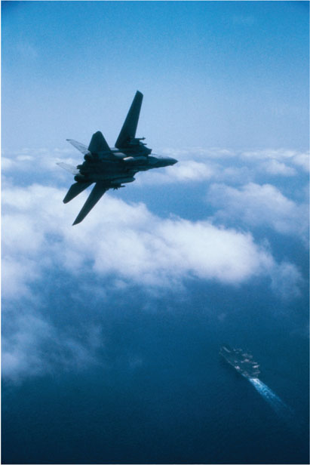
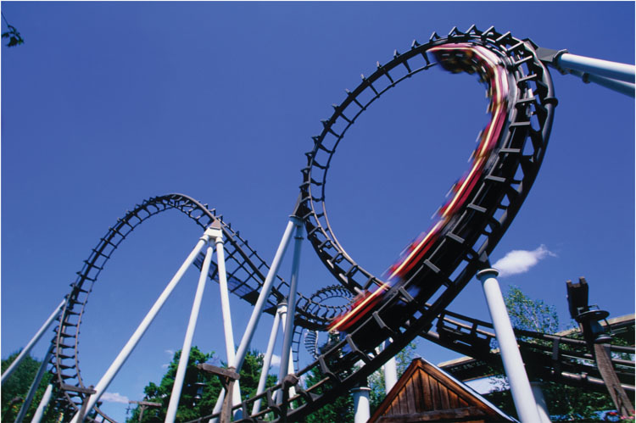
Kinetics: Normal and Tangential Coordinates
Aircraft and roller coasters can both experience large normal forces during turns.
© Purestock/SuperStock RF, Alan Schein/Getty Images

Slide 33
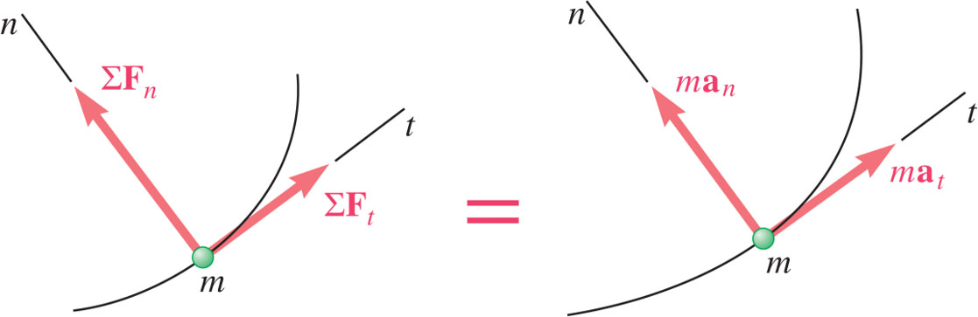
Equations of Motion 2
Newton’s second law
For tangential and normal components,

Slide 34
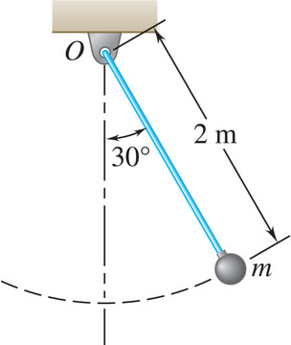
Sample Problem 12.6 1
Strategy:
Resolve the equation of motion for the bob into tangential and normal components.
Solve the component equations for the normal and tangential accelerations.
Solve for the velocity in terms of the normal acceleration.
The bob of a 2-m pendulum describes an arc of a circle in a vertical plane. If the tension in the cord is 2.5 times the weight of the bob for the position shown, find the velocity and accel-eration of the bob in that position.

Slide 35
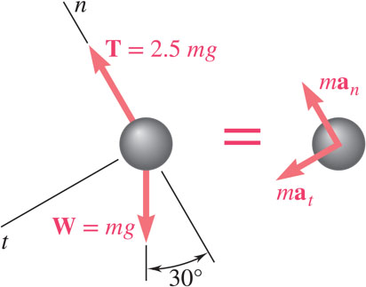
Sample Problem 12.6 2
Modeling and Analysis:
Resolve the equation of motion for the bob into tangential and normal components.
Solve the component equations for the normal and tangential accelerations.
Solve for velocity in terms of normal acceleration.

Slide 36
Sample Problem 12.6 3
Reflect and Think:
If you look at these equations for an angle of zero instead of 30º, you will see that when the bob is straight below point O, the tangential acceleration is zero, and the velocity is a maximum. The normal acceleration is not zero because the bob has a velocity at this point.

Slide 37
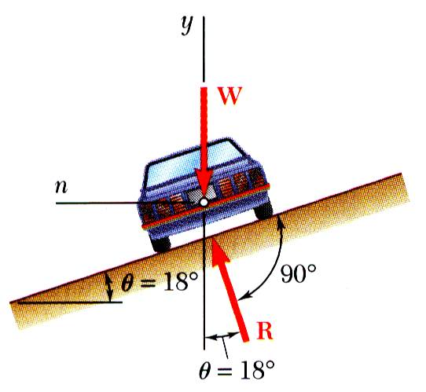
Sample Problem 12.7 1
Strategy:
The car travels in a horizontal circular path with a normal component of acceleration directed toward the center of the path. The forces acting on the car are its weight and a normal reaction from the road surface.
Resolve the equation of motion for the car into vertical and normal components.
Determine the rated speed of a highway curve of radius ρ = 120 m banked through an angle θ = 18º. The rated speed of a banked highway curve is the speed at which a car should travel if no lateral friction force is to be exerted at its wheels.
Solve for the vehicle speed.

Slide 38
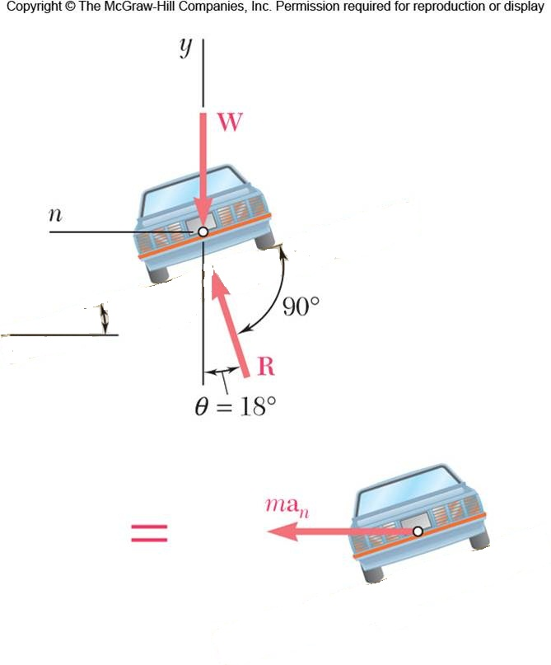
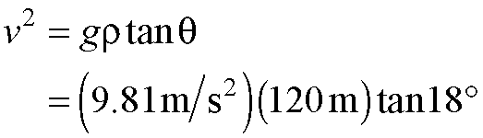
Sample Problem 12.7 2
Resolve the equation of motion for the car into vertical and normal components.
SOLUTION:
Modeling and Analysis:
The car travels in a horizontal circular path with a normal component of acceleration directed toward the center of the path. The forces acting on the car are its weight and a normal reaction from the road surface.
Solve for the vehicle speed.

Slide 39
Sample Problem 12.7 3
Reflect and Think:
For a highway curve, this seems like a reasonable speed for avoiding a spin-out. If the roadway were banked at a larger angle, would the rated speed be larger or smaller than this calculated value?
For this problem, the tangential direction is into the page; since you were not asked about forces or accelerations in this direction, you did not need to analyze motion in the tangential direction.

Slide 40
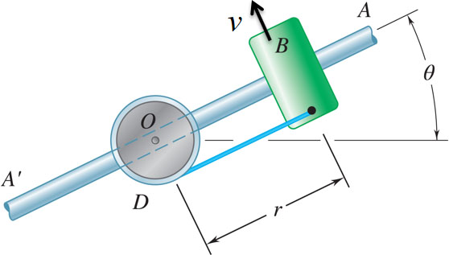
Group Problem Solving 5
STRATEGY:
Draw the FBD and KD for the collar.
Write the equations of motion for the collar.
Determine kinematics of the collar.
The 3-kg collar B rests on the frictionless arm AA′. The collar is held in place by the rope attached to drum D and rotates about O in a horizontal plane. The linear velocity of the collar B is increasing according to
Combine the equations of motion with kinematic relationships and solve.
where v is in m/s and t is in sec. Find the tension in the rope and the force of the bar on the collar after 5 seconds if r = 0.4 m.

Slide 41
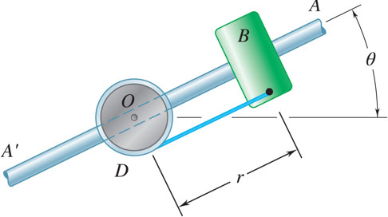
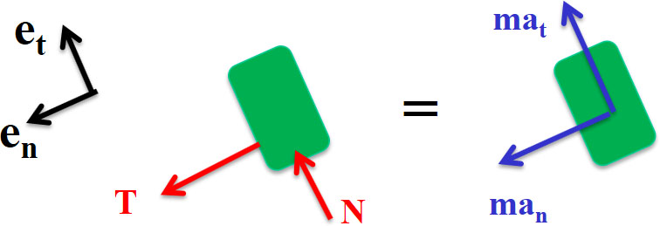
Group Problem Solving 6
Modeling and Analysis:
Given:
r = 0.4 m
Find: T and N at t = 5 sec
Draw the FBD and KD of the collar
Write the equations of motion

Slide 42
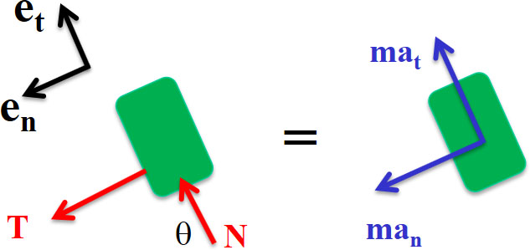
Group Problem Solving 7
Kinematics : find v_{t}, a_{n}, a_{t}
Substitute into equations of motion

Slide 43
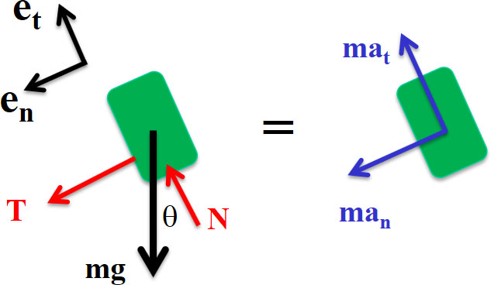
Group Problem Solving 8
Reflect and Think:
How would the problem change if motion was in the vertical plane?
You would add an mg term and would also need to calculate θ
When is the tangential force greater than the normal force?
Only at the very beginning, when starting to accelerate. In most applications, a_{n} >> a_{t}

Slide 44
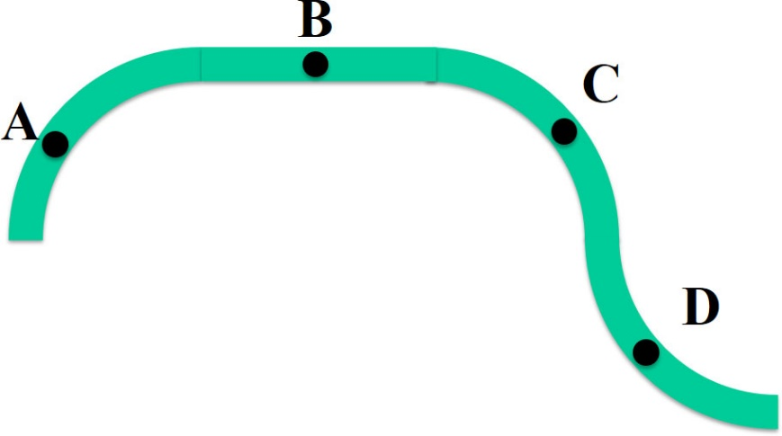
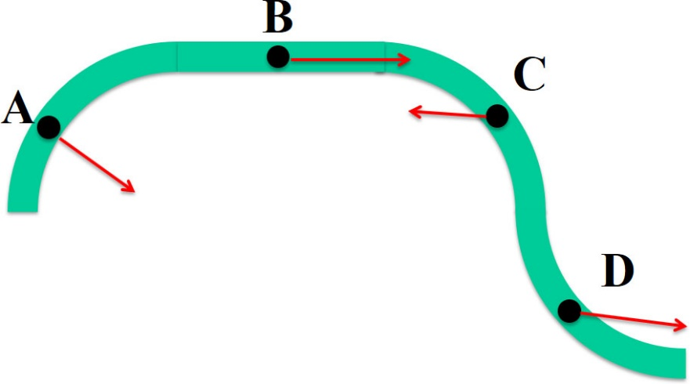
Concept Question
A car is driving from A to D on the curved path shown. The driver is doing the following at each point:
A – going at a constant speed B – stepping on the accelerator
C – stepping on the brake D – stepping on the accelerator
Draw the approximate direction of the car’s acceleration at each point.

Slide 45

Kinetics: Radial and Transverse Coordinates
Hydraulic actuators, extending robotic arms, and centrifuges as shown below are often analyzed using radial and transverse coordinates.

Slide 46
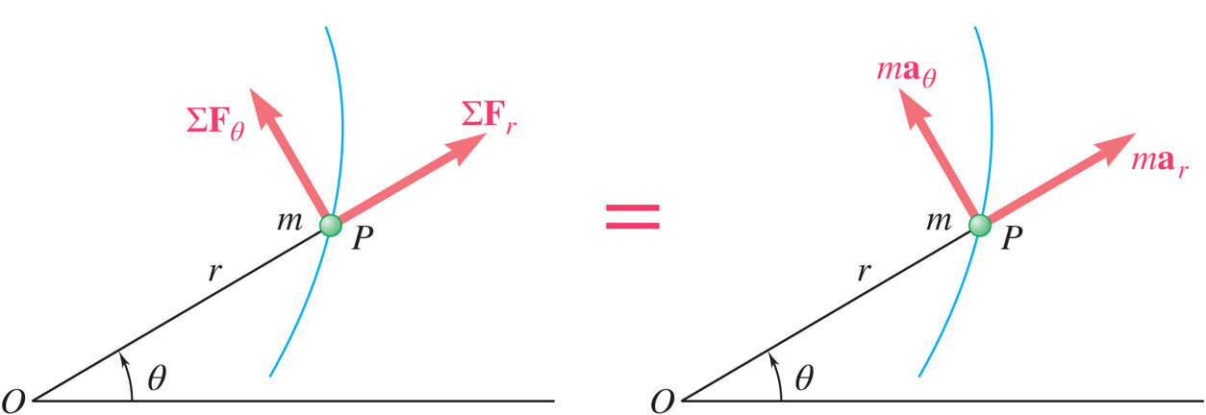
Eqs of Motion in Radial & Transverse Components 1
Consider particle at r and θ, in polar coordinates,

Slide 47

Sample Problem 12.10 1
Strategy:
Write the radial and transverse equations of motion for the block.
Integrate the radial equation to find an expression for the radial velocity.
A block B of mass m can slide freely on a frictionless arm OA which rotates in a horizontal plane at a constant rate
Substitute known information into the transverse equation to find an expression for the force on the block.
Knowing that B is released at a distance r₀ from O, express as a function of r
a) the component v_{r} of the velocity of B along OA, and
b) the magnitude of the horizontal force exerted on B by the arm OA.

Slide 48

Sample Problem 12.10 2
Integrate the radial equation to find an expression for the radial velocity.
Modeling and Analysis:
Write the radial and transverse equations of motion for the block.
Substitute known information into the transverse equation to find an expression for the force on the block.

Slide 49

Sample Problem 12.10 3
Reflect and Think:
Introducing radial and transverse components of force and acceleration involves using components of velocity as well in the computations. But this is still much simpler and more direct than trying to use other coordinate systems.
Even though the radial acceleration is zero, the collar accelerates relative to the rod with acceleration $\ddot{r}$.

Slide 50

Group Problem Solving 9
Strategy:
Draw the FBD and KD for the collar.
Write the equations of motion for the collar.
Determine kinematics of the collar.
Combine the equations of motion with kinematic relationships and solve.
The 3-kg collar B slides on the frictionless arm AA′. The arm is attached to drum D and rotates about O in a horizontal plane at the rate where and t are expressed in rad/s and seconds, respectively. As the arm-drum assembly rotates, a mechanism within the drum releases the cord so that the collar moves outward from O with a constant speed of 0.5 m/s. Knowing that at t = 0, r = 0, determine the time at which the tension in the cord is equal to the magnitude of the horizontal force exerted on B by arm AA′.

Slide 51

Group Problem Solving 10
MODELING and ANALYSIS:
Given:
Find: time when T = N
Draw the FBD and KD of the collar
Write the equations of motion

Slide 52
Group Problem Solving 11
Kinematics: find expressions for r and θ
Substitute values into a_{r} , a_{θ}
Substitute into equation of motion
Set T = N

Slide 53

Concept Quiz 3
The top view of a spinning platform is shown. A girl starts walking towards the outside of the spinning platform, as shown in the figure by the black box. She is walking at a constant rate with respect to the platform, and the platform rotates at a constant rate. In which direction(s) will the forces act on her?
a) +e₁
b) − e₁
c) +e₂
d) − e₂
e) The forces are zero in the e₁ and e₂ directions

Slide 54
Concept Quiz 4
The top view of a spinning platform is shown. A girl starts walking towards the outside of the spinning platform, as shown in the figure by the black box. She is walking at a constant rate with respect to the platform, and the platform rotates at a constant rate. In which direction(s) will the forces act on her?
a) +e₁
b) − e₁
c) +e₂
d) − e₂
e) The forces are zero in the e₁ and e₂ directions

Slide 55


Angular Momentum of a Particle 1
Satellite orbits are analyzed using conservation of angular momentum.
Source: NASA/JSC

Slide 56


Eqs of Motion in Radial & Transverse Components 2
Consider particle at r and θ, in polar coordinates,
This result may also be derived from conservation of angular momentum,

Slide 57


Angular Momentum of a Particle 2
moment of momentum or the angular momentum of the particle about O.
is perpendicular to plane containing
Derivative of angular momentum with respect to time,
It follows from Newton’s second law that the sum of the moments about O of the forces acting on the particle is equal to the rate of change of the angular momentum of the particle about O.

Slide 58


Conservation of Angular Momentum 1
When only force acting on particle is directed toward or away from a fixed point O, the particle is said to be moving under a central force.
Since the line of action of the central force passes through O,
Position vector and motion of particle are in a plane perpendicular to
Magnitude of angular momentum,

Slide 59

Conservation of Angular Momentum 2
Radius vector OP sweeps infinitesimal area
Define
areal velocity
Recall, for a body moving under a central force,
When a particle moves under a central force, its areal velocity is constant.

Slide 60

Newton’s Law of Gravitation
Gravitational force exerted by the sun on a planet or by the earth on a satellite is an important example of gravitational force.
Newton’s law of universal gravitation - two particles of mass M and m attract each other with equal and opposite force directed along the line connecting the particles,
For particle of mass m on the earth’s surface,

Slide 61

Sample Problem 12.12 1
Strategy:
Since the satellite is moving under a central force, its angular momentum is constant. Equate the angular momentum at A and B and solve for the velocity at B.
A satellite is launched in a direction parallel to the surface of the earth with a velocity of 30,000 km/h from an altitude of 400 km. Determine the velocity of the satellite as it reaches it maximum altitude of 4000 km. The radius of the earth is 6370 km.

Slide 62

Sample Problem 12.12 2
Modeling and Analysis:
Since the satellite is moving under a central force, its angular momentum is constant. Equate the angular momentum at A and B and solve for the velocity at B.
Reflect and Think:
Note that in order to increase velocity, a spacecraft often applies thrusters to push it closer to the earth. This central force means the spacecraft’s angular momentum remains constant, its radial distance r decreases, and its velocity v increases.

Slide 63
Trajectory of a Particle Under a Central Force
For particle moving under central force directed towards force center,
Second expression is equivalent to
from which,
After substituting into the radial equation of motion and simplifying,
If F is a known function of r or u, then particle trajectory may be found by integrating for u = f(θ), with constants of integration determined from initial conditions.

Slide 64

Application to Space Mechanics 1
Consider earth satellites subjected to only gravitational pull of the earth,
Solution is equation of conic section,
Origin, located at earth’s center, is a focus of the conic section.
Trajectory may be ellipse, parabola, or hyperbola depending on value of eccentricity.

Slide 65

Application to Space Mechanics 2
Trajectory of earth satellite is defined by,
hyperbola,
The radius vector becomes infinite for,
parabola,
The radius vector becomes infinite for,
ellipse,
The radius vector is finite for θ and is constant, that is a circle, for ε < 0.

Slide 66


Application to Space Mechanics 3
Integration constant C is determined by conditions at beginning of free flight, θ = 0, r = r₀ ,
Satellite escapes earth orbit for
Trajectory is elliptic for v₀ < v_{esc} and becomes circular for ε = 0 or C = 0,

Slide 67

Application to Space Mechanics 4
Recall that for a particle moving under a central force, the areal velocity is constant, that is,
Periodic time or time required for a satellite to complete an orbit is equal to area within the orbit divided by areal velocity,
where

Slide 68

Sample Problem 12.14 1
Strategy:
Trajectory of the satellite is described by,
A satellite is launched in a direction parallel to the surface of the earth with a velocity of 36,900 km/h at an altitude of 500 km.
Evaluate C using the initial conditions at θ = 0.
Determine the maximum altitude by finding r at θ = 180º.
Determine:
a) the maximum altitude reached by the satellite, and
b) the periodic time of the satellite.
With the altitudes at the perigee and apogee known, the periodic time can be evaluated.

Slide 69

Sample Problem 12.14 2
Modeling and Analysis:
Trajectory of the satellite is described by
Evaluate C using the initial conditions at θ = 0.

Slide 70

Sample Problem 12.14 3
Determine the maximum altitude by finding r₁ at θ = 180º.
With the altitudes at the perigee and apogee known, the periodic time can be evaluated.

Slide 71

Sample Problem 12.14 4
Reflect And Think:
The satellite takes less than one day to travel over 60,000 km from the earth and back. In this problem, you started with Equation 12.37, but it is important to remember that this formula was the solution to a differential equation that was derived using Newton’s second law.

Slide 72
Kepler’s Laws of Planetary Motion
Results obtained for trajectories of satellites around earth may also be applied to trajectories of planets around the sun.
Properties of planetary orbits around the sun were determined astronomical observations by Johann Kepler (1571 to 1630) before Newton had developed his fundamental theory.
Each planet describes an ellipse, with the sun located at one of its foci.
The radius vector drawn from the sun to a planet sweeps equal areas in equal times.
The squares of the periodic times of the planets are proportional to the cubes of the semimajor axes of their orbits.

Slide 73
End of Chapter 12

